Slide 1
Artificial Intelligence and Machine Learning
CITS5503
Week 10
Dr Anwarul Patwary

Slide 2
AI on AWS

Slide 3
In summary
Amazon Rekognition, an image analysis and facial recognition service.
Amazon Polly, a text-to-speech service.
Amazon Lex, which uses automatic speech recognition and natural language understanding to create chatbots and conversational interfaces.
Amazon Machine Learning, which contains a series of visualization tools to analyze data without the need to learn complex machine learning code.
Amazon Elastic MapReduce (EMR), a managed Hadoop framework designed to perform log analysis, predictive analytics, real-time analytics, and other big data operations.
Spark, an Apache product that runs inside of Amazon EMR as a distributed processing system for big data workloads.

Slide 4
And even more…
AI frameworks
Apache MXNet, Tensorflow, etc
Computing resources GPUs, Clusters, AWS Lambda

Slide 5
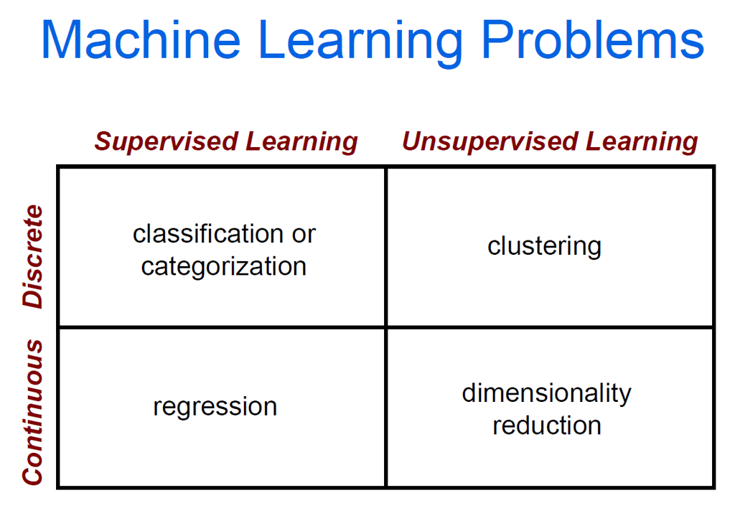
Courtesy: James Tompkin Brown University

Slide 6
Clustering Strategies
K-means
Iteratively re-assign points to the nearest cluster center
Agglomerative clustering
Start with each point as its own cluster and iteratively merge the closest clusters
Mean-shift clustering
Estimate modes (maxima) of a probability density function
Spectral clustering
Split the nodes in a graph based on assigned links with similarity weights

Slide 8
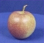
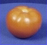
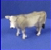
The machine learning framework
Apply a prediction function to a feature representation of the image to get the desired output:
f( ) = “apple”
f( ) = “tomato”
f( ) = “cow”
Slide credit: L. Lazebnik

Slide 9
The machine learning framework
y = f(x)
Training: given a training set of labeled examples {(x₁,y₁), …, (x_{N},y_{N})}, estimate the prediction function f by minimizing the prediction error on the training set
Testing: apply f to a never before seen test example x and output the predicted value y = f(x)
output
prediction function
Image feature
Slide credit: L. Lazebnik

Slide 10
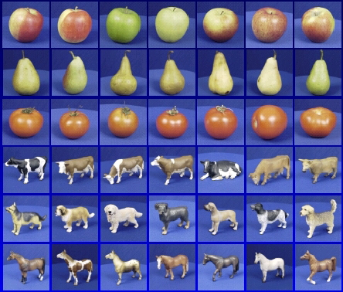
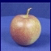
Steps
Training
Training Labels
Training Images
Image Features
Training
Learned model
Testing
Image Features
Learned model
Prediction
Test Image
Slide credit: D. Hoiem and L. Lazebnik

Slide 11

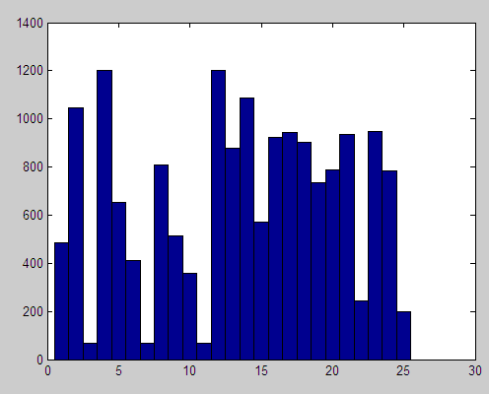

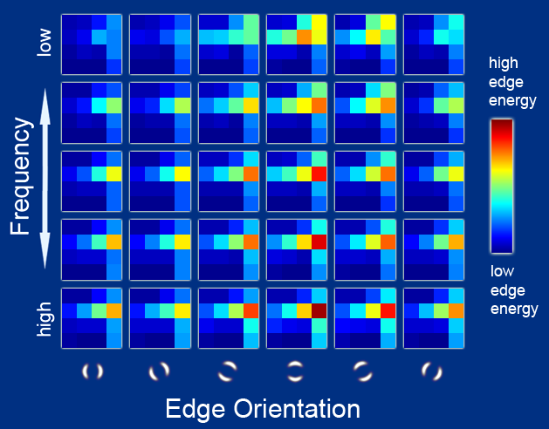
Features
Raw pixels
Histograms
GIST descriptors
…
Slide credit: L. Lazebnik

Slide 12
Classifiers: Nearest neighbor
Test example
Training examples from class 2
Training examples from class 1
f(x) = label of the training example nearest to x
All we need is a distance function for our inputs
No training required!
Slide credit: L. Lazebnik

Slide 13
Classifiers: Linear
Find a linear function to separate the classes:
f(x) = sgn(w ⋅ x + b)
Slide credit: L. Lazebnik

Slide 14
Many classifiers to choose from
Which is the best one?
SVM
Neural networks
Naïve Bayes
Bayesian network
Logistic regression
Randomized Forests
Boosted Decision Trees
K-nearest neighbor
RBMs
Etc.
Slide credit: D. Hoiem

Slide 15

Recognition task and supervision
Images in the training set must be annotated with the “correct answer” that the model is expected to produce
Contains a motorbike
Slide credit: L. Lazebnik

Slide 16
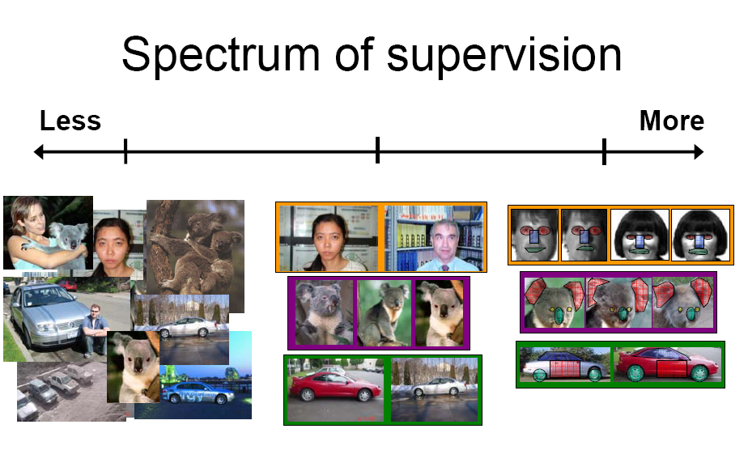
Unsupervised
“Weakly” supervised
Fully supervised
Definition depends on task
Slide credit: L. Lazebnik

Slide 17
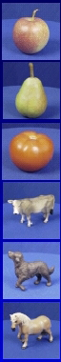
Generalization
Training set (labels known)
Test set (labels unknown)
How well does a learned model generalize from the data it was trained on to a new test set?
Slide credit: L. Lazebnik

Slide 18
Generalization
Components of generalization error
Bias: how much the average model over all training sets differ from the true model?
Error due to inaccurate assumptions/simplifications made by the model
Variance: how much models estimated from different training sets differ from each other
Underfitting: model is too “simple” to represent all the relevant class characteristics
High bias and low variance
High training error and high test error
Overfitting: model is too “complex” and fits irrelevant characteristics (noise) in the data
Low bias and high variance
Low training error and high test error
Slide credit: L. Lazebnik

Slide 19
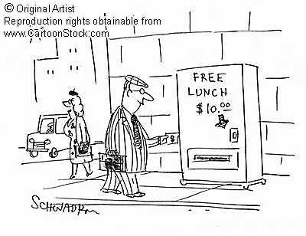
No Free Lunch Theorem
Slide credit: D. Hoiem
Notes:
You can only get generalization through assumptions.

Slide 20
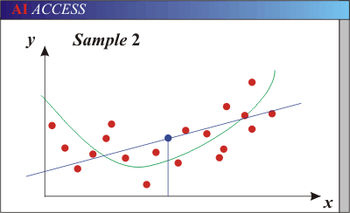
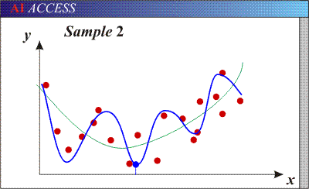
Bias-Variance Trade-off
Models with too few parameters are inaccurate because of a large bias (not enough flexibility).
Models with too many parameters are inaccurate because of a large variance (too much sensitivity to the sample).
Slide credit: D. Hoiem
Notes:
http://www.aiaccess.net/English/Glossaries/GlosMod/e_gm_bias_variance.htm

Slide 21
Bias-Variance Trade-off
Total Error = Bias² + Variance + Irreducible Error (noise)
See the following for explanations of bias-variance :
http://scott.fortmann-roe.com/docs/BiasVariance.html
Slide credit: D. Hoiem
Notes:
From the link above:
You can only get generalization through assumptions.
Thus in order to minimize the MSE, we need to minimize both
the bias and the variance. However, this is not trivial to do this. For instance, just
neglecting the input data and predicting the output somehow (e.g., just a constant), would definitely minimize the variance of our predictions: they would be
always the same, thus the variance would be zero—but the bias of our estimate
(i.e., the amount we are off the real function) would be tremendously large. On
the other hand, the neural network could perfectly interpolate the training data,
i.e., it predict y=t for every data point. This will make the bias term vanish entirely, since the E(y)=f (insert this above into the squared bias term to verify this),
but the variance term will become equal to the variance of the noise, which may
be significant (see also Bishop Chapter 9 and the Geman et al. Paper). In general,
finding an optimal bias-variance tradeoff is hard, but acceptable solutions can be
found, e.g., by means of cross validation or regularization.

Slide 22
Bias-variance tradeoff
Underfitting
Overfitting
Error
Test error
Training error
High Bias
Low Variance
Complexity
Low Bias
High Variance
Slide credit: D. Hoiem

Slide 23
Bias-variance tradeoff
Few training examples
Test Error
Many training examples
High Bias
Low Variance
Complexity
Low Bias
High Variance
Slide credit: D. Hoiem
Notes:
Note: these figures don’t work in pdf

Slide 24
Effect of Training Size
Fixed prediction model
Error
Testing
Generalization Error
Training
Number of Training Examples
Slide credit: D. Hoiem

Slide 25
Remember…
No classifier is inherently better than any other: you need to make assumptions to generalize
Three kinds of error
Inherent: unavoidable
Bias: due to over-simplifications
Variance: due to inability to perfectly estimate parameters from limited data
Slide credit: D. Hoiem
Slide credit: D. Hoiem
Notes:
You can only get generalization through assumptions.

Slide 26
How to reduce variance?
Choose a simpler classifier
Regularize the parameters
Get more training data
Slide credit: D. Hoiem
Notes:
The simpler classifier or regularization could increase bias and lead to more error.

Slide 27
Very brief tour of some classifiers
K-nearest neighbor
SVM
Boosted Decision Trees
Neural networks
Naïve Bayes
Bayesian network
Logistic regression
Randomized Forests
RBMs
Etc.

Slide 28
Practicalities of Machine Learning
Data for training and testing
Images, Text, Audio, Video, Structured Data
Models
The trained network to fulfill a specific purpose based on specific data
Loss functions
Training error: error obtained when model is run on training data
Test error: error obtained when model is run on unseen data
Optimisation Algorithms
Algorithms to minimise error

Slide 29
ML Models and uses
Binary Classification (logistic regression)
"Is this email spam or not spam?"
"Will the customer buy this product?"
Multiclass Classification (multinomial logistic regression)
"Is this product a book, movie, or clothing?"
"Is this movie a romantic comedy, documentary, or thriller?"
"Which category of products is most interesting to this customer?”
Regression (linear regression)
"What will the temperature be in Crawley tomorrow?"
"For this product, how many units will sell?"
"What price will this house sell for?"

Slide 30
AWS Machine Learning
Datasource: metadata about input data
Name
Location (S3, Redshift, MySQL)
Observation
Schema
Summary statistics
ML Models
Regression
Multiclass
Binary
Model Size, Number of Passes, Regularisation

Slide 31
AWS Machine Learning (2)
Evaluations: means by which a model is assessed
Model insights: overall summary of predictive performance of a model
AUC: Area under the ROC Curve: ability of a binary model to predict a higher score for positive examples than negative examples
Macro-averaged F1-score: evaluate predictive performance of multiclass models
RMSE: Root Mean Square Error evaluates predictive performance of regression models
Cut-off: discriminant value converted to 0 and 1 labels
Accuracy: % correct predictions
Precision and Recall (sensitivity)

Slide 32
Precision and Recall
A dog recognition program recognises 8 dogs in a picture of 12 dogs and some cats
Of the 8 dogs, 5 are true positives (actual dogs) and 3 are cats (false positives)
Programs precision is 5/8 and recall 5/12
F1 score
harmonic mean of precision and recall
precision * recall
F1 = 2 * ---------------------
precision + recall

Slide 33
Building a Machine Learning Application
Collect labeled data
Target data – data labelled with correct answer
Variables/features: attributes of the data
Analyse your data
Data clean: missing data, outliers, abhorrent data
Understand the data: dominant variables, relationships, descriptive statistics
Variable-target correlations: high correlation → higher predictive power
Feature processing
Replacing missing data with meaningful default
Cartesian products: e.g. urban,suburban, rural * state
Non-linear transformations: e.g. age into bins
Domain-specific features: e.g. length, breadth, height combined as volume
Variable-specific features: e.g. text as n-grams

Slide 34
Building a Machine Learning App (2)
Split data into training (70-80%) and evaluation (30-20%)
either the first 70% or random selection
Select an ML Model
AWS ML uses a linear model for learning: calculates the relative weights for variables in calculating a target
For learning, uses a combination of a loss function and optimisation algorithm
Optimisation algorithm is Stochastic Gradient Descent (SGD)
Learning algorithms:
Binary classification: Logistic regression
Multiclass classification: Multinomial logistic regression
Regression: linear regression (squared loss function)

Slide 35
Training parameters
Few parameters that can be tuned or left to defaults
Learning rate
Model size
Number of passes
Data shuffling
Regularization

Slide 36
Model accuracy
Accuracy measures depend on ML model type
Binary
Multiclass
Regression

Slide 37
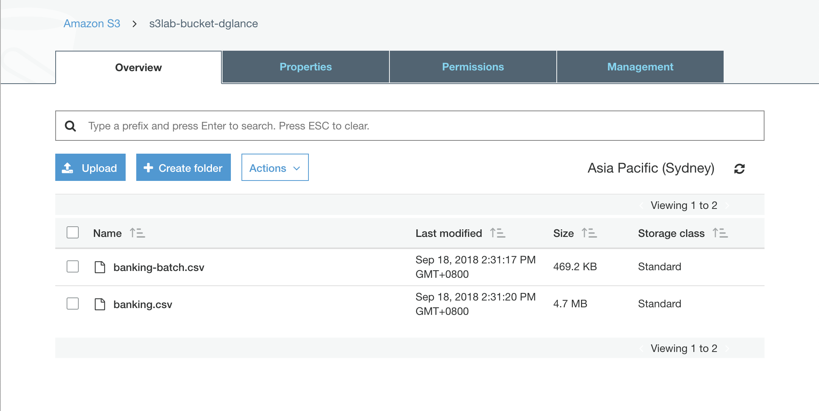
Demo: Creating a model
Upload source files (banking.csv and banking-batch.csv) to S3

Slide 38
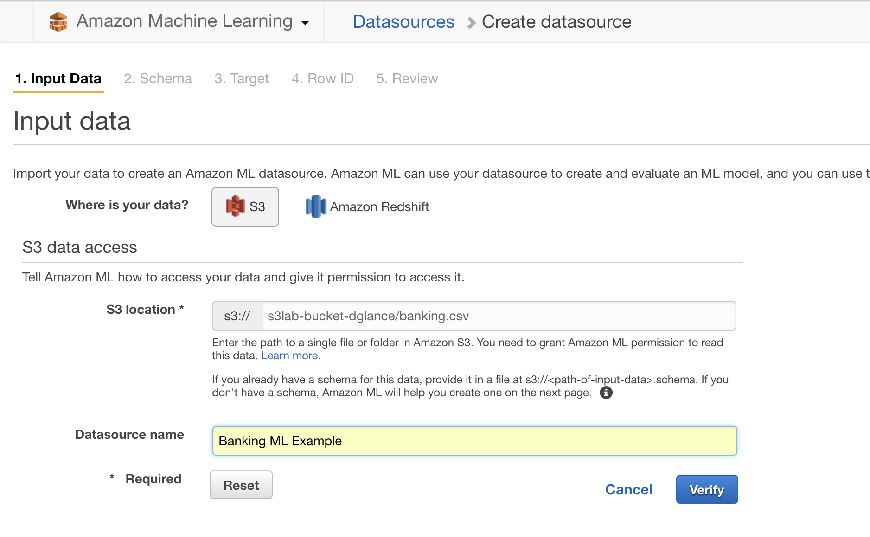
2. Create a datasource

Slide 39
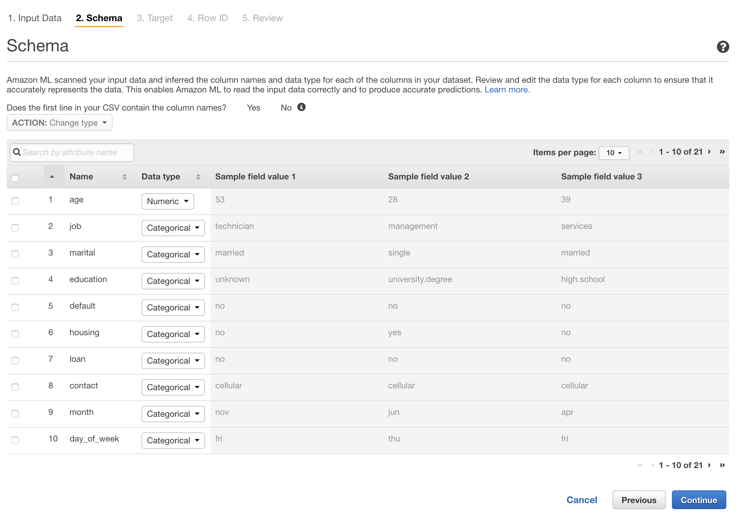
Accept default schema (auto-generated)
Need to select target – the final column of the banking csv
Shows whether customer took the product proposal or not

Slide 40
3. Create a ML Model
AWS will auto-generate a “recipe”
Parameters can be overridden
% data used for training and % used for evaluation
Transformation of data
Memory allocated
Number of passes
Regularization

Slide 41
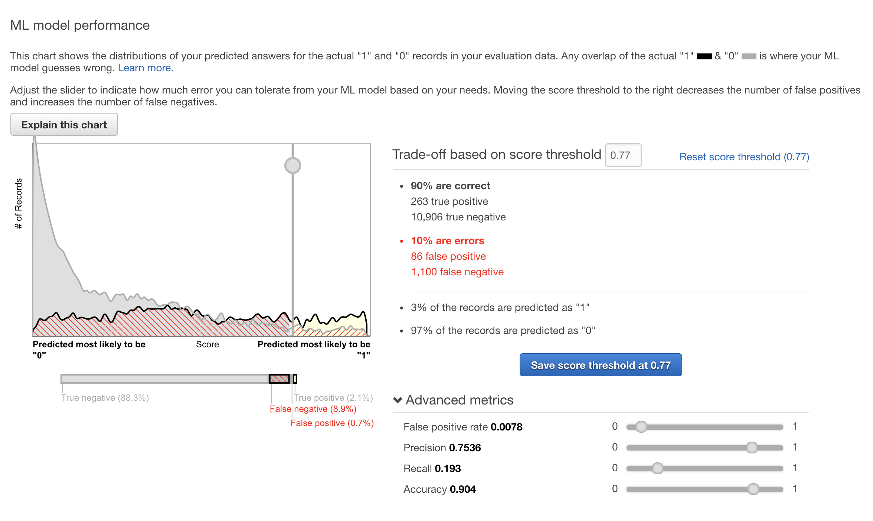
4 Run the evaluation
Can select score threshold depending on performance characteristics
Note that although the model performance is rated as good, the ability to detect true positives is only 75% (Precision is 0.75)

